Slide 1

VEGA FEVER

Slide 2
AGENDA
Introduction
Product
Market
Marketing Strategy
Team
Future Plans
Call to Action

Slide 3
INTRO-DUCTION
Welcome to the world of Vega Fever, where fashion meets technology and sustainability. Our innovative color-changing clothing is designed to adapt to your unique style and environment, creating a dynamic and expressive visual experience. With a commitment to sustainability and a passion for innovation, Vega Fever is redefining the fashion industry for the modern consumer. Join us on this journey as we explore the future of fashion.

Slide 4
PRIMARY GOALS
Annual revenue growth

Slide 5
Goal 1
Develop and launch Vega Fever's mobile app, allowing customers to easily access the company's products and engage with the brand.
Complete app development and testing by Q1.
Launch a professional web app by Q2.
Promote app through targeted marketing campaigns and partnerships with influencers by Q3.

Slide 6
Goal 2
Expand Vega Fever's product offerings to cater to a wider range of customers, including new designs and additional color options.
Conduct market research to identify customer preferences and trends by Q1.
Develop new product designs and colors based on research findings by Q2.
Launch new product offerings and analyze sales data and customer feedback by Q3.

Slide 7
Goal 3
Establish Vega Fever as a leading sustainable fashion brand, with a commitment to eco-friendly materials, ethical production processes, and social responsibility.
Develop and implement a sustainability plan, including eco-friendly materials and ethical production processes by Q1.
Establish partnerships with sustainable fashion organizations and influencers by Q2.
Host sustainability-focused events and campaigns and analyze impact on brand awareness and sales by Q3.

Slide 8
Business opportunities are like buses. There's always another one coming.
“
”
Richard Branson

Slide 9
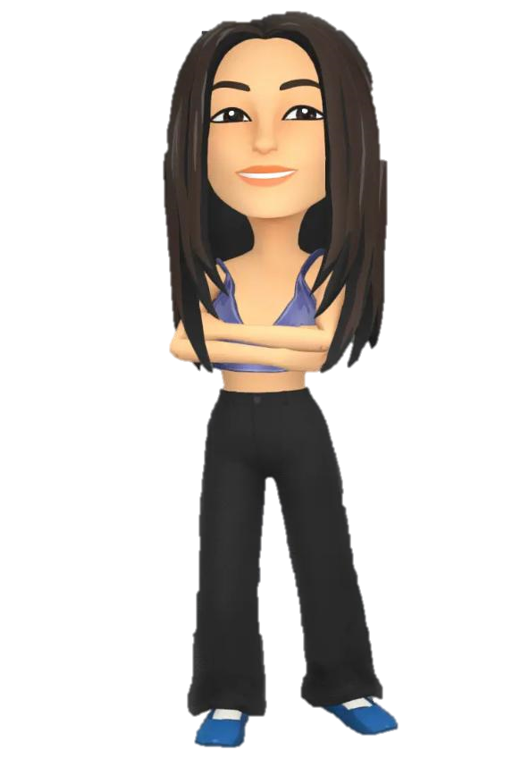
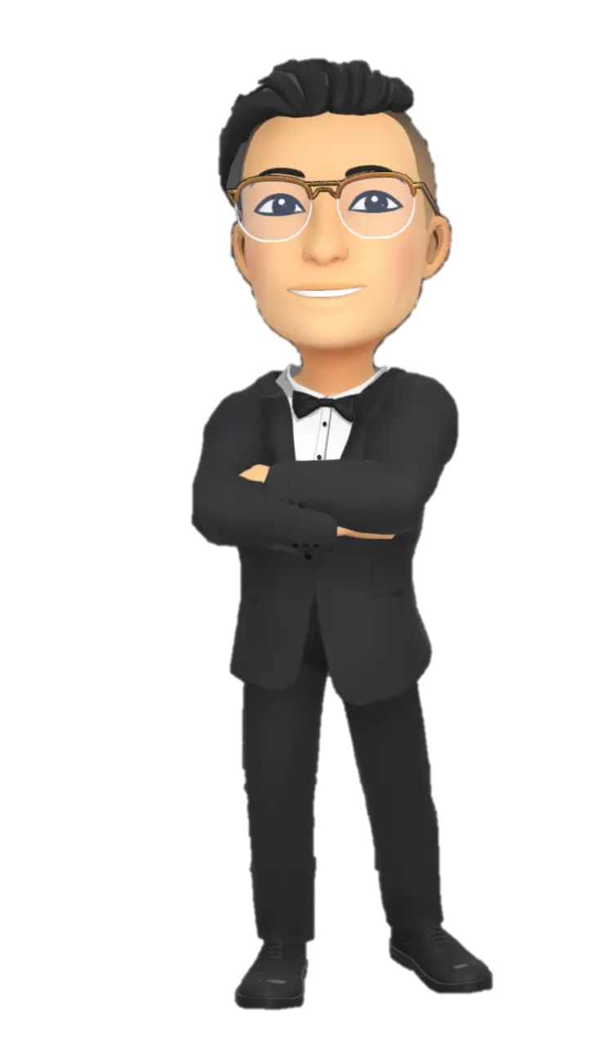
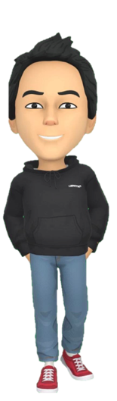
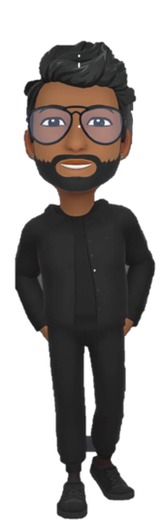

MEET OUR TEAM
Akshata kutnikar
President
Reyansh srivastav
Vaibhav guliani
Chief Operations Officer​
VP Technology​
Vinayaka polimera
Arshpreet Kaur
Chief Executive Officer​
VP Marketing​

Slide 10
PLAN FOR PRODUCT LAUNCH
PLANNING
MARKETING
DESIGN
STRATEGY
LAUNCH
Define the product line and target audience
Research and identify potential suppliers, manufacturers, and distributors
Develop a budget and timeline for the launch
Develop a marketing strategy that emphasizes the unique features and benefits of Vega Fever's color-changing clothing
Leverage social media and influencers to build buzz and excitement around the launch
Host a launch event or pop-up shop to showcase the product and generate interest
Work with designers and manufacturers to develop a range of designs and color options
Ensure that the color-changing technology is integrated seamlessly into the fabric and design of the clothing
Test and refine the designs to ensure optimal performance and user experience
Develop a pricing strategy that balances the cost of production with market demand
Establish partnerships with sustainable fashion brands or retailers to expand reach and increase credibility
Consider offering customization options to customers to further differentiate Vega Fever from competitors
Set a launch date and communicate it through marketing channels
Ensure that inventory is ready for the launch and that production and distribution are properly aligned
Monitor customer feedback and adjust marketing or design strategies as necessary to ensure optimal success of the launch

Slide 11
TIMELINE
Planning and Research
Marketing and Promotion
Growth and Expansion
APR 2023
OCT 2023
Feb 2024
Design and Development
Launch and Customer Feedback
JUL 2023
NOV 2023

Slide 12
AREAS OF FOCUS
Product Innovation
Sustainability and Ethical production
Vega Fever could focus on continuing to develop and improve its color-changing clothing technology, expanding the range of color options, or exploring other technological innovations to differentiate its product line even further.
Vega Fever could focus on enhancing its sustainability and ethical production practices by using even more environmentally-friendly materials and manufacturing methods, or by partnering with organizations that promote ethical and sustainable fashion practices.

Slide 13
HOW WE GET HERE
Industry disruption
Market Research
Sustainability and Innovation
Vega Fever may have identified an opportunity to disrupt the traditional fashion industry by combining innovative technology with sustainable and eco-friendly practices, thus appealing to a growing market of environmentally-conscious consumers who are seeking unique and versatile fashion options.
Vega Fever may have conducted extensive market research and identified a gap in the market for sustainable, innovative clothing that allows for self-expression and personalization, leading to the development of its color-changing clothing line.
The founders of Vega Fever may have a deep passion for sustainability and innovation and saw an opportunity to combine these passions in a way that could make a positive impact on the fashion industry and society as a whole. This passion may have driven the development and launch of the company

Slide 14
SUMMARY
Vega Fever is a sustainable fashion brand that offers innovative, color-changing clothing that incorporates NFC modules and fiber optic cables for unique and attention-grabbing effects. The brand is focused on engaging with a diverse and fashion-forward audience, who are passionate about sustainability and innovation in their fashion choices. Vega Fever's mission is to establish a strong brand identity and build a loyal community of environmentally-conscious consumers who appreciate the blend of technology and fashion in their clothing.

Slide 15
THANK YOU

